Slide 1
Signals and Systems

Slide 2
Unit-2 Analysis of Continuous Time Signals

Slide 3
Contents
Sl No. | Content
1 | Introduction to Fourier series
2 | Representation of Continuous time Periodic signal
3 | Fourier series: Trigonometric representation
4 | Fourier series: Cosine representation
5 | Symmetry conditions
6 | Properties of Continuous time Fourier series
7 | Practice problems on Fourier series
8 | Gibb’s Phenomenon, Parseval’s relation for power signals
9 | Power density spectrum, Frequency spectrum.

Slide 4
Introduction to Fourier Series
The study of signals and systems using sinusoidal representation is termed as Fourier analysis.
The representations are based on the periodicity and whether the given signal is a continuous time signal or discrete time signal.
All periodic signals have Fourier series representation.
If the signal is periodic and continuous time signal, it will have continuous time Fourier series representation.
If the given signal is periodic and discrete time signal, it will have discrete time Fourier series representation.
All non periodic signals have Fourier transform representation.

Slide 5
Representation of Continuous time Periodic signals

Slide 6
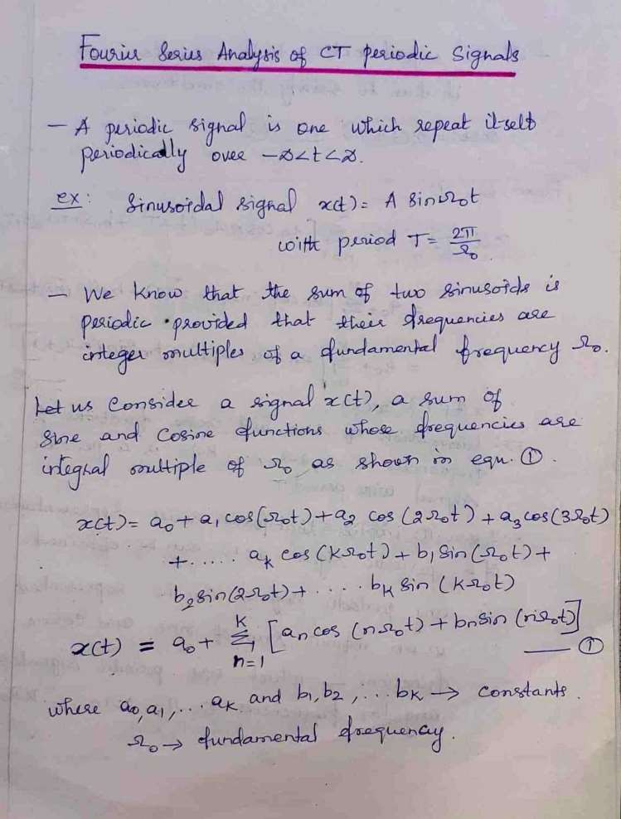

Slide 7
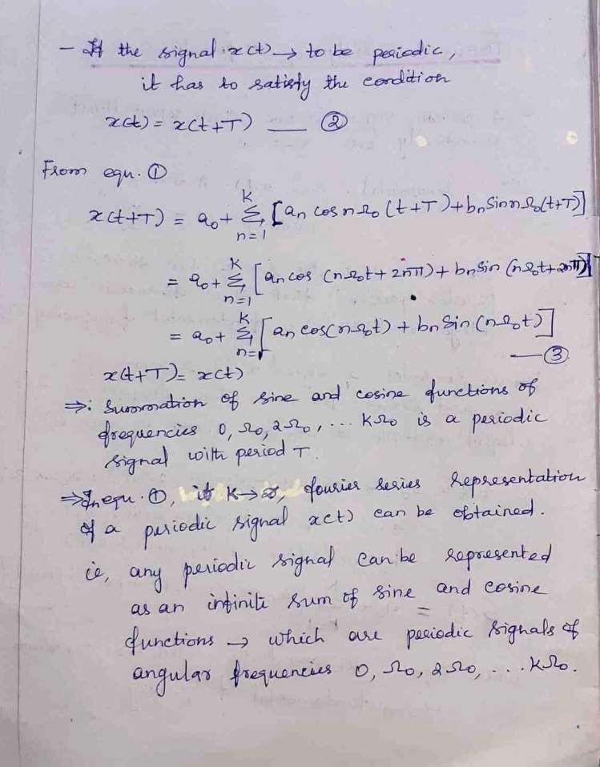

Slide 8
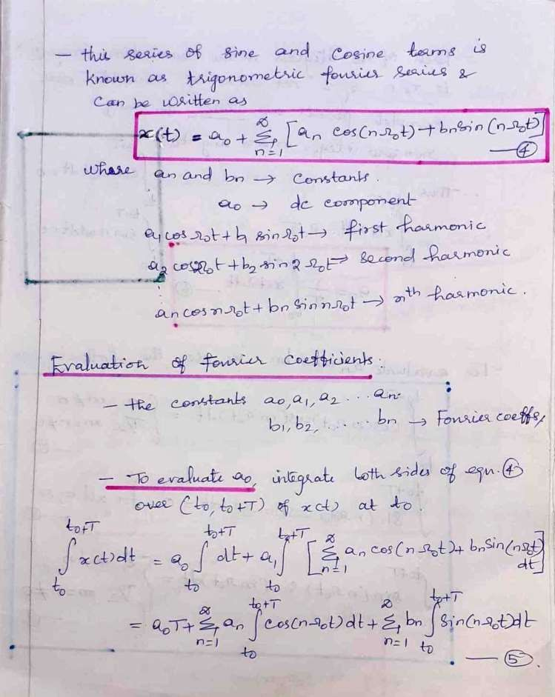

Slide 9
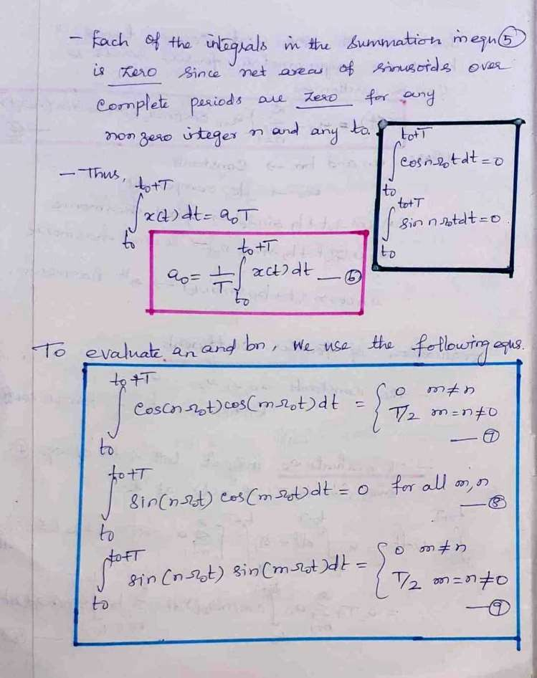

Slide 10
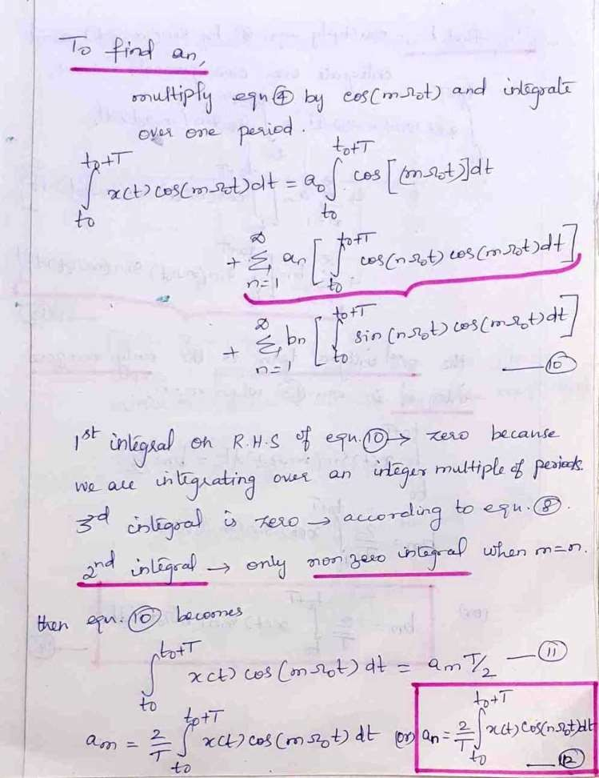

Slide 11
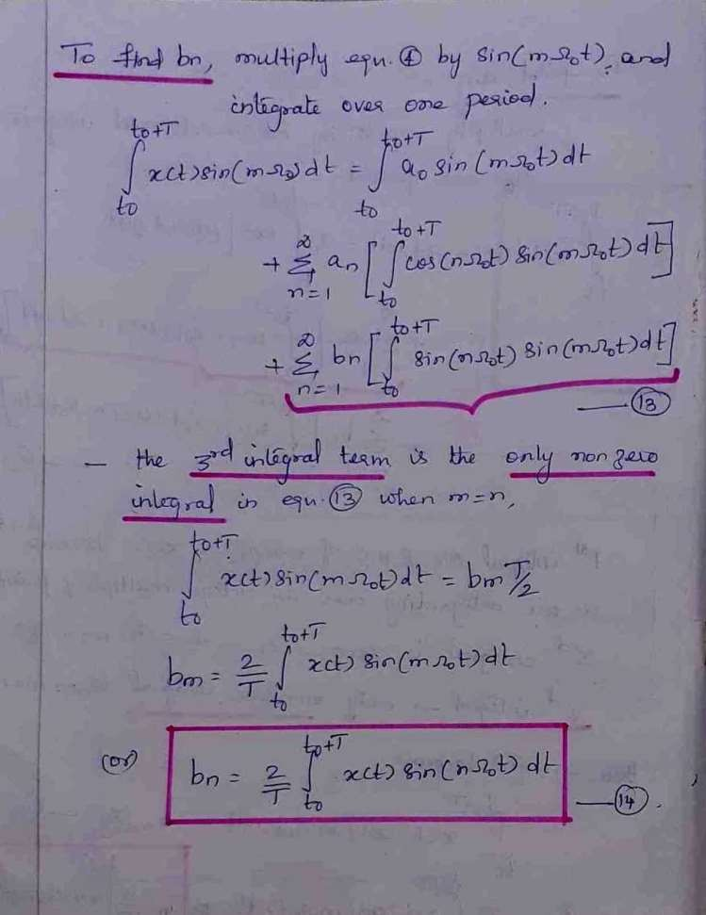

Slide 12




Trigonometric Fourier series equations

Slide 13
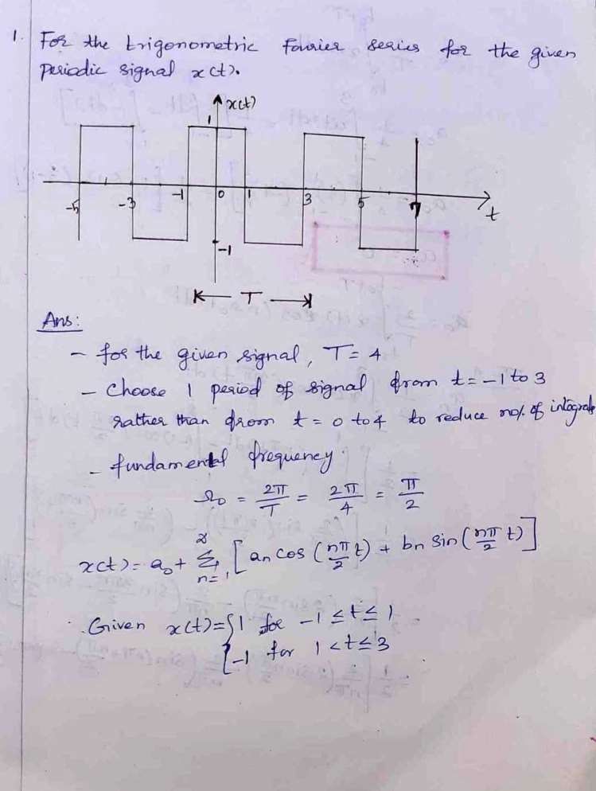

Slide 14
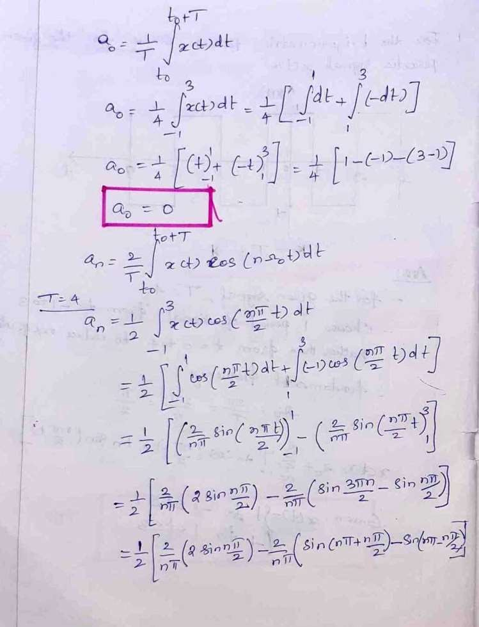

Slide 15
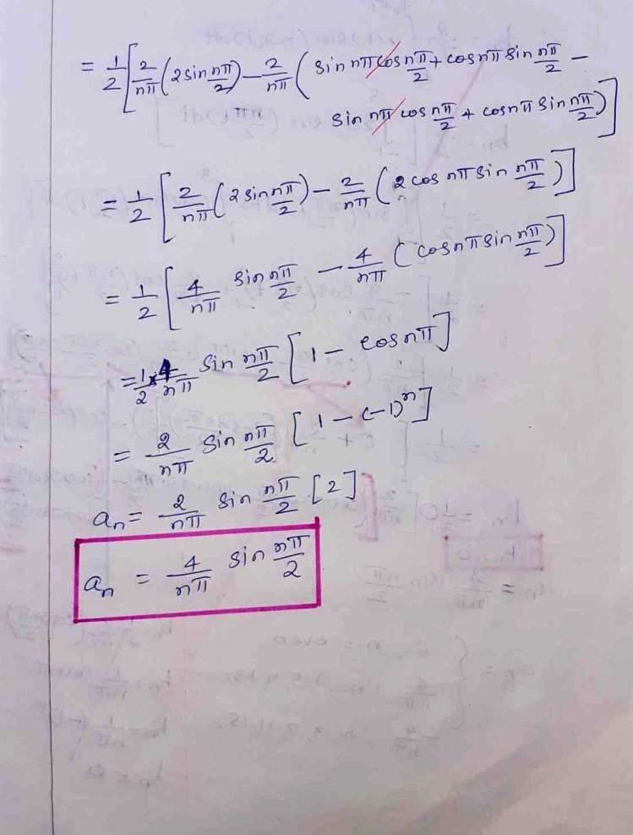

Slide 16
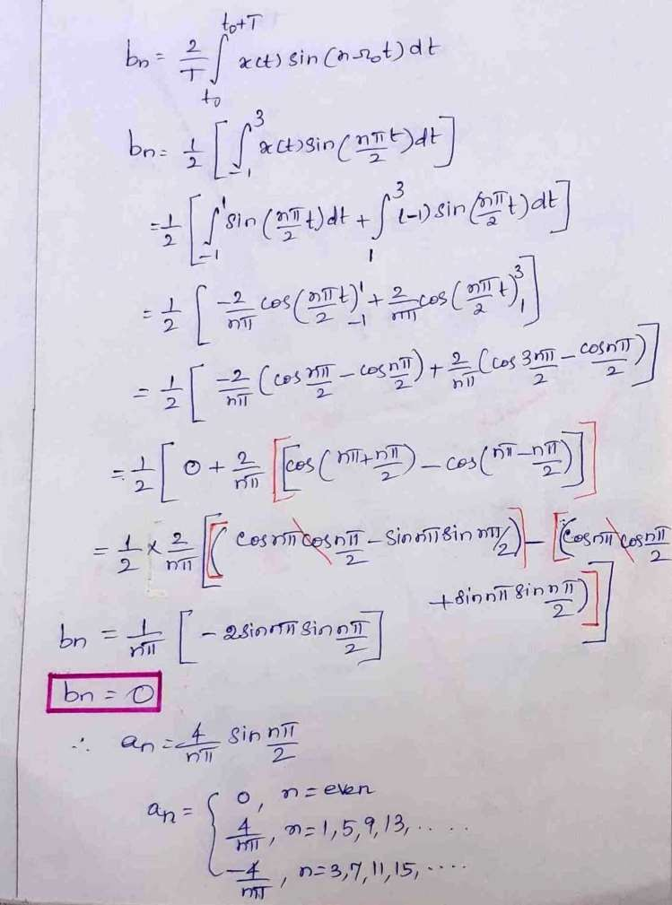

Slide 17
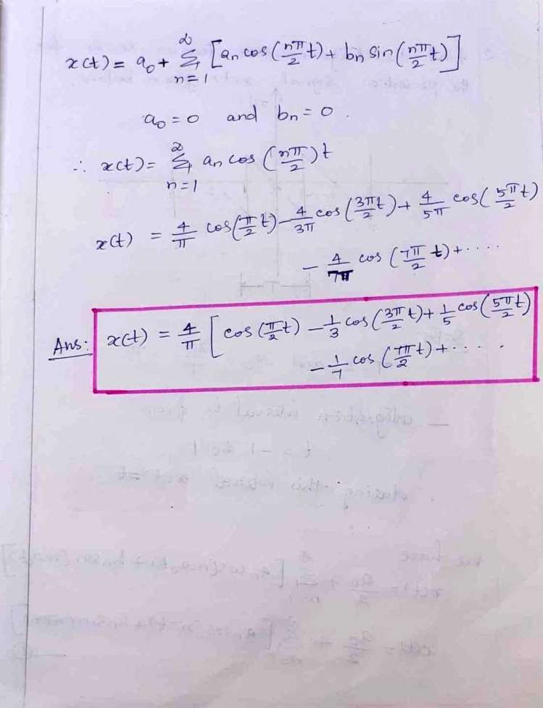

Slide 18
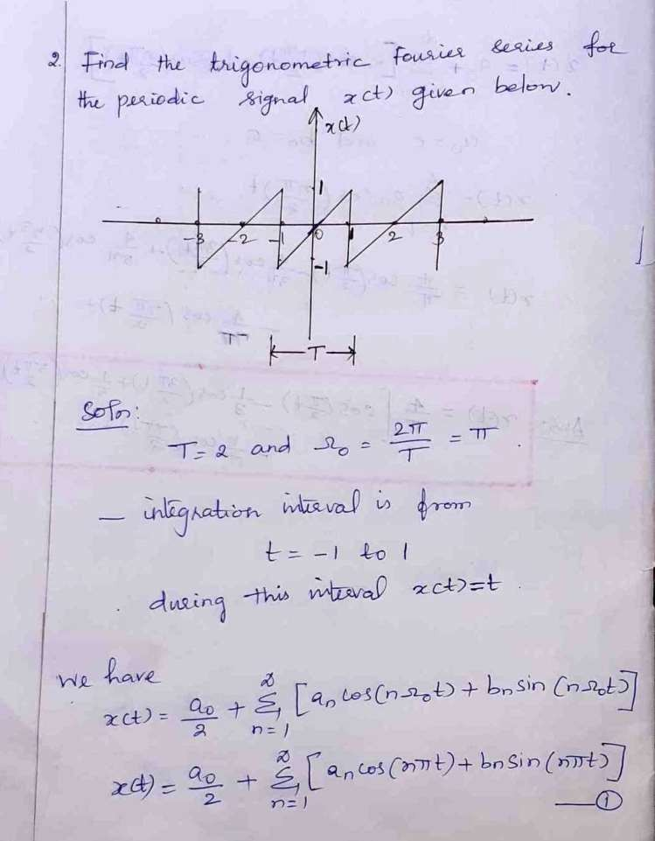

Slide 19
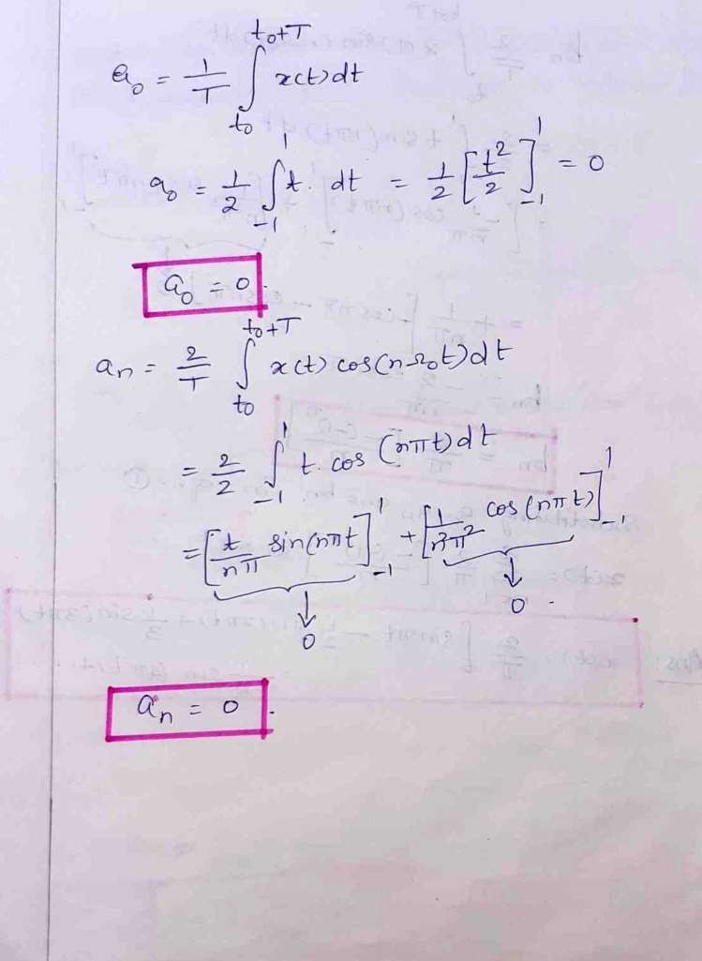

Slide 20
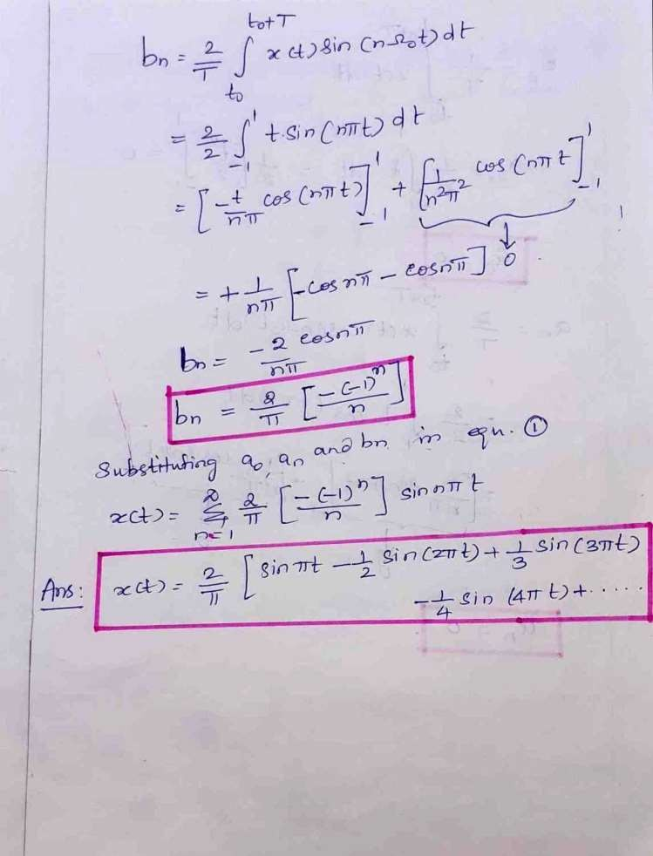

Slide 21
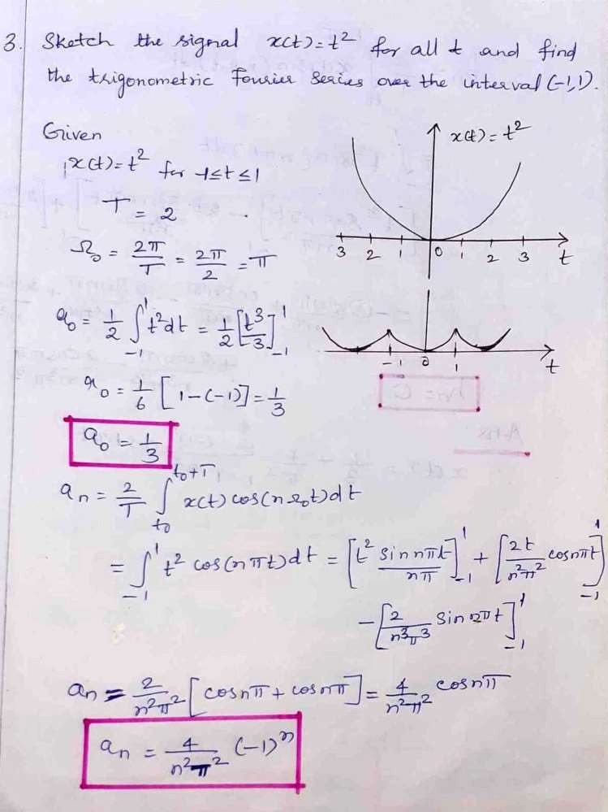

Slide 22
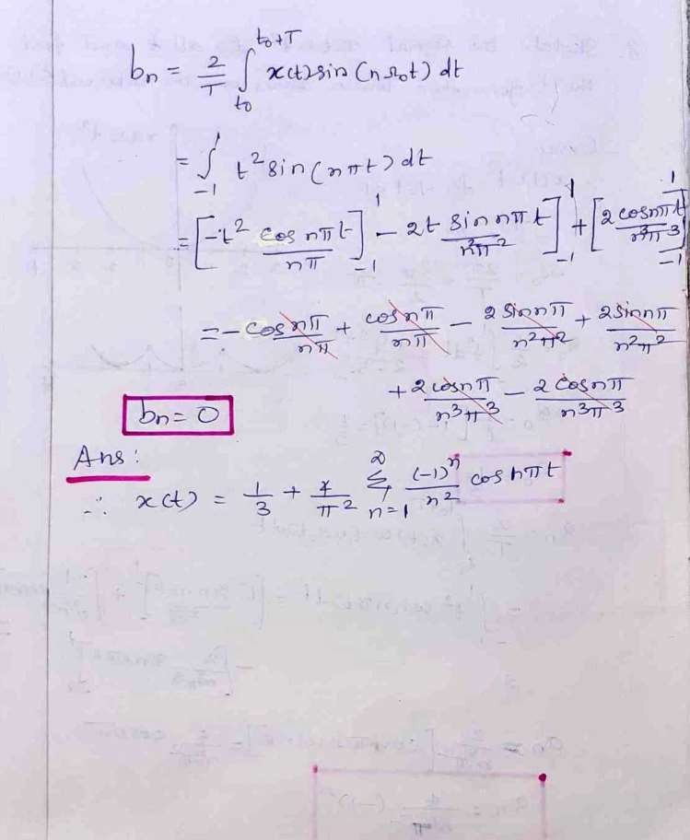

Slide 23
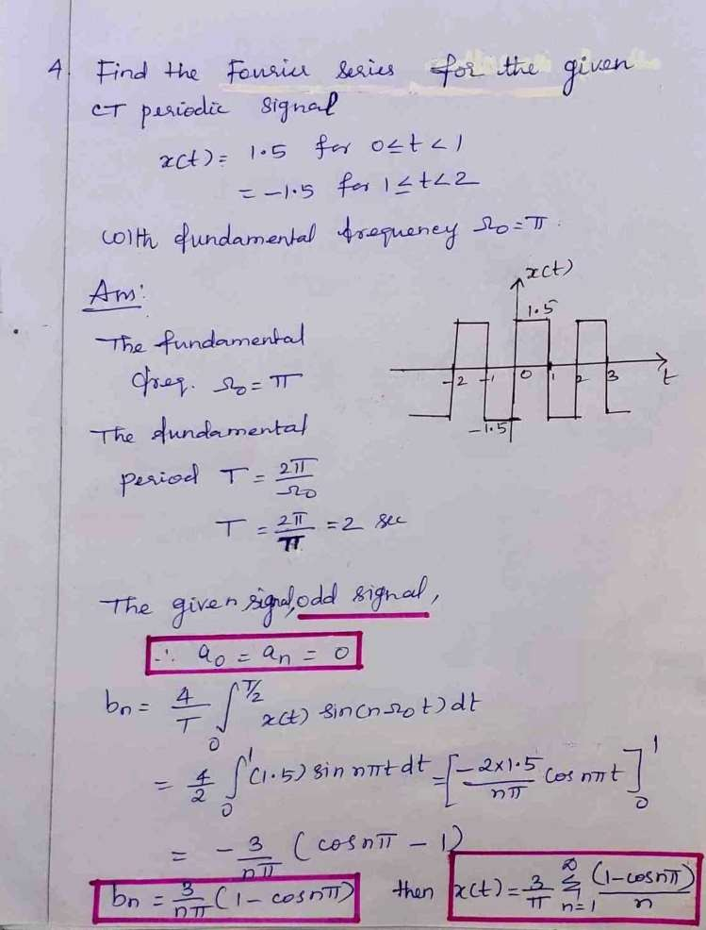

Slide 24
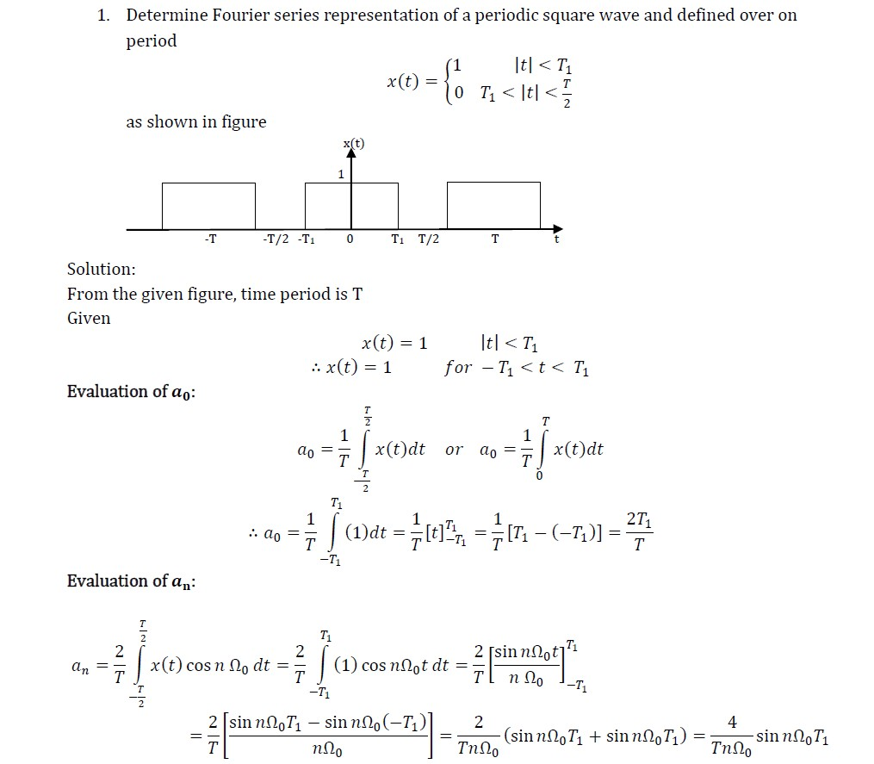
Practice Problems

Slide 25
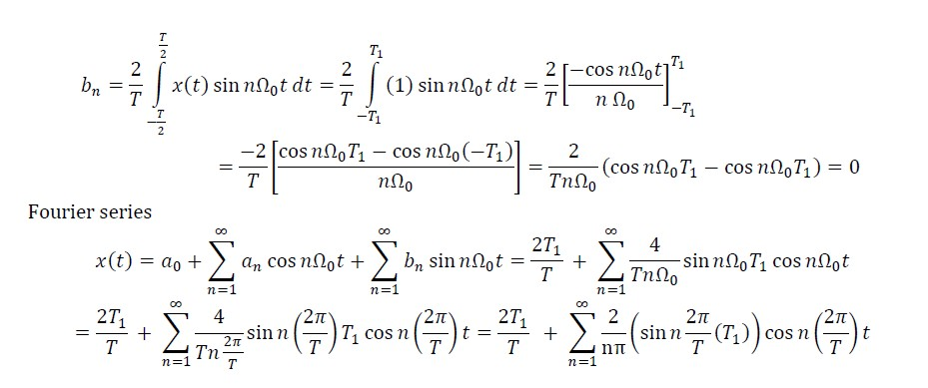

Slide 26
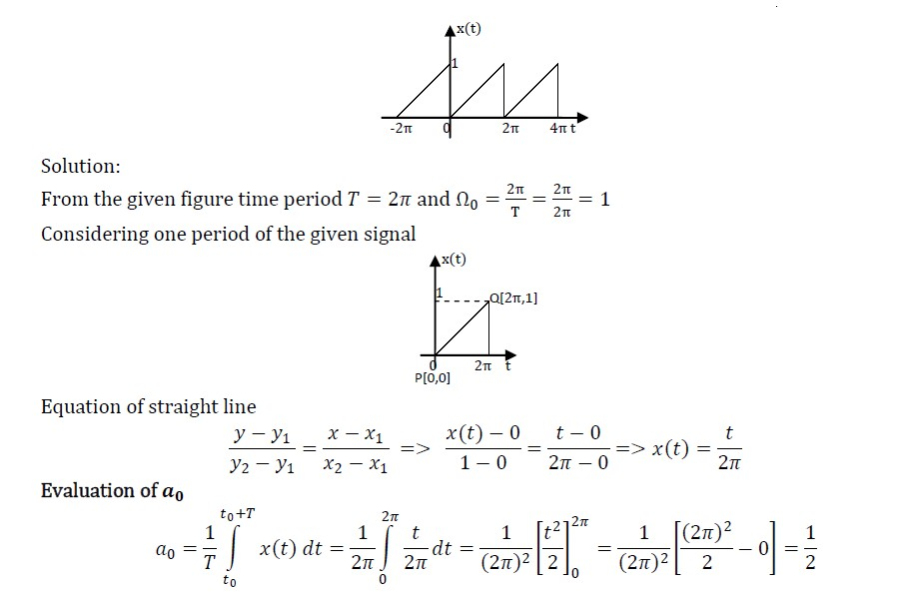
2. Find the Trigonometric series coefficients for the figure given

Slide 27
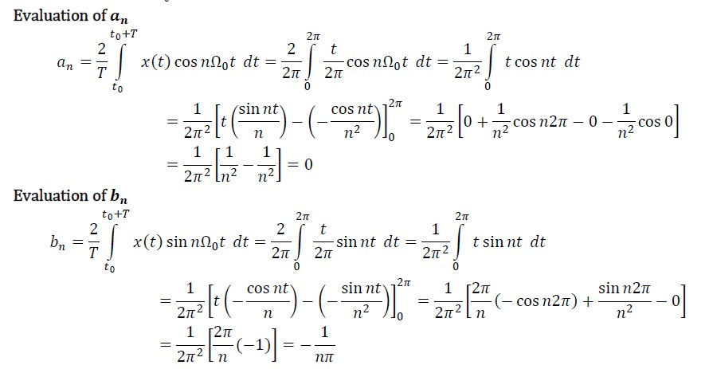

Slide 28
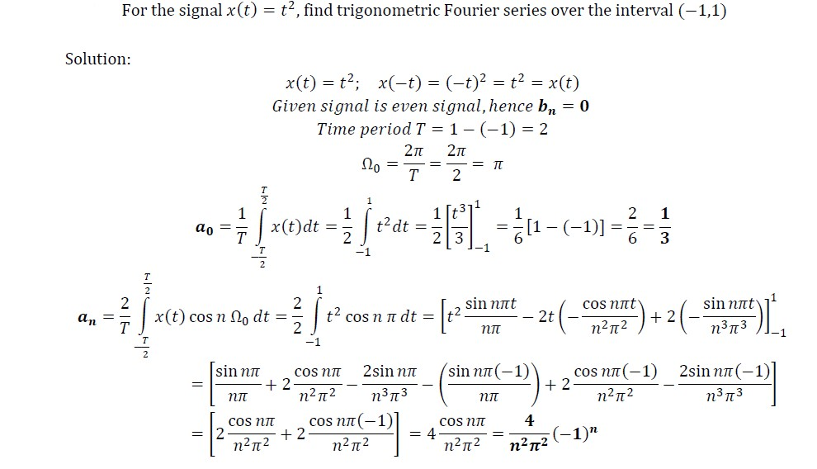
3.

Slide 29
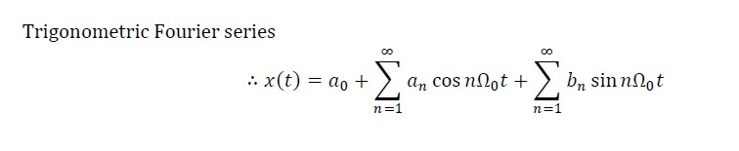
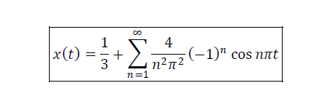
Sub a0, an, bn values we get
we get

Slide 30
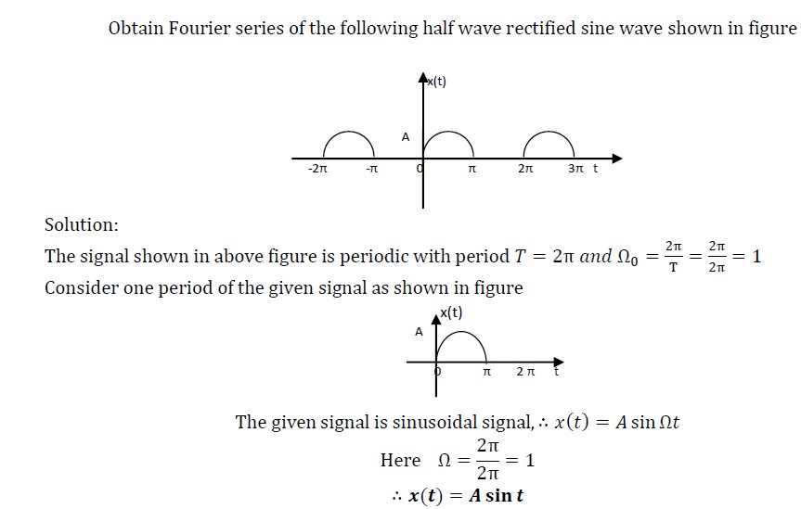
4.

Slide 31
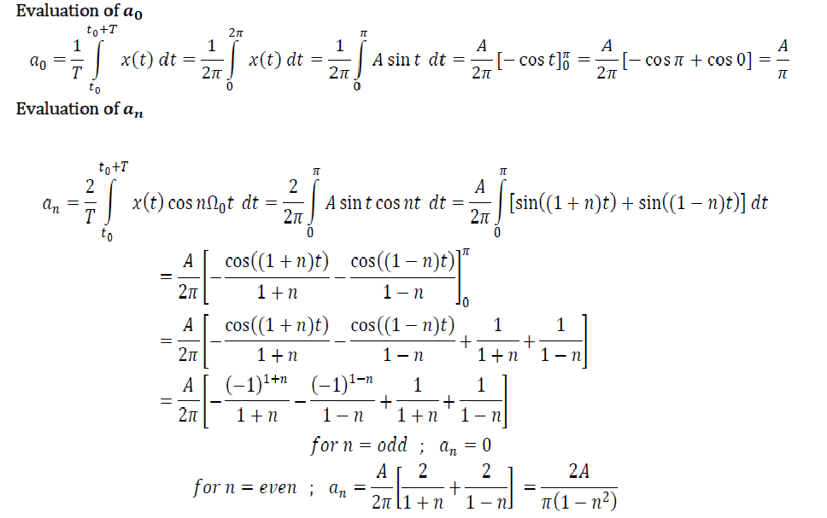

Slide 32
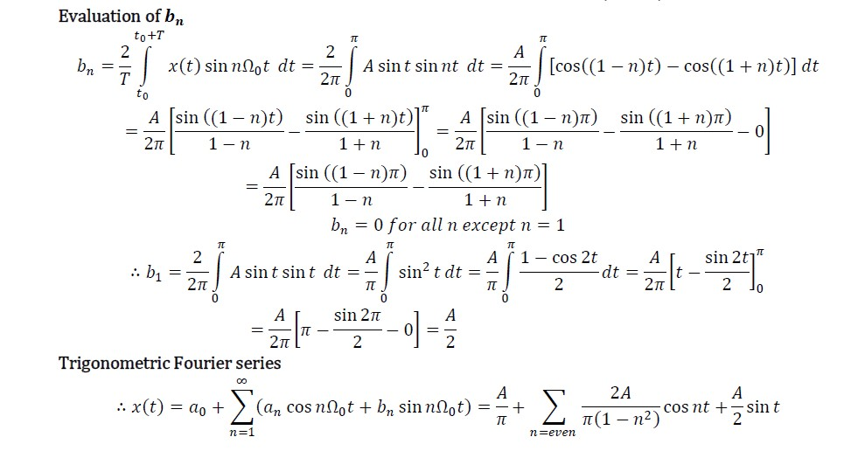

Slide 33
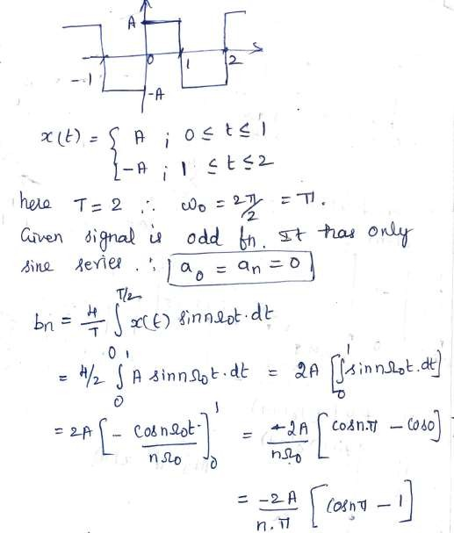
5. Find the Trigonometric series coefficients for the figure given

Slide 34
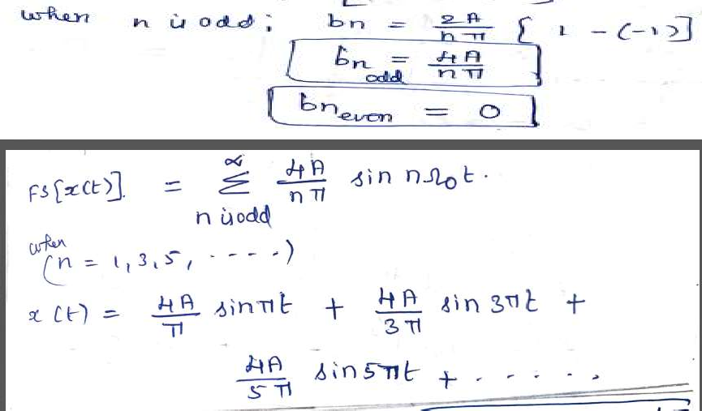

Slide 35
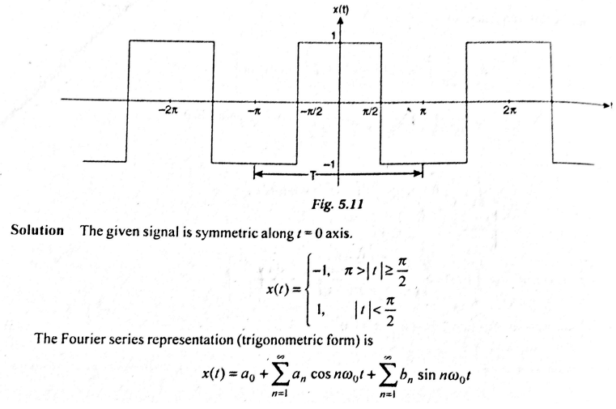
6. Find the Fourier series representation (trigonometric form) of the signal

Slide 36
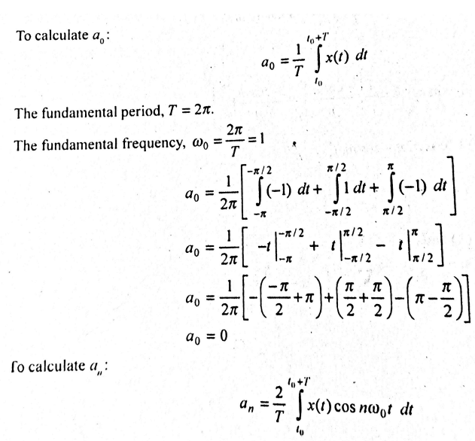
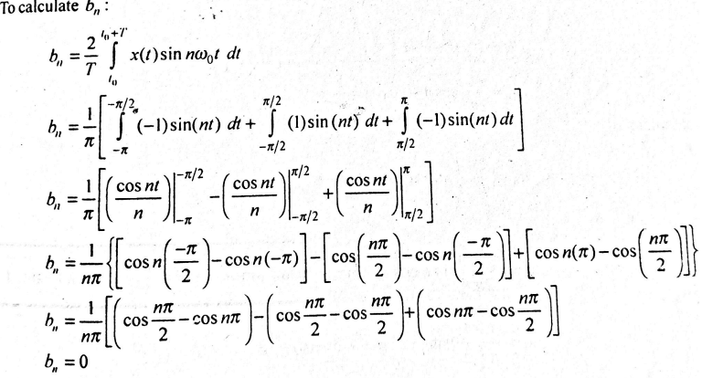
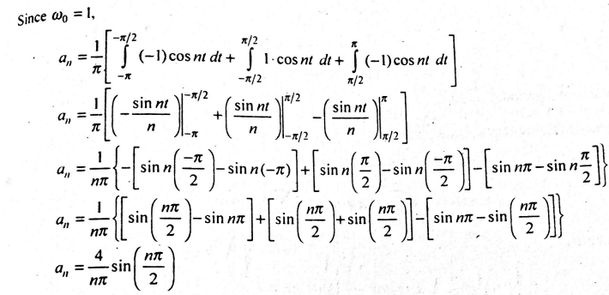

Substituting a0, an, bn in x(t) equation

Slide 37
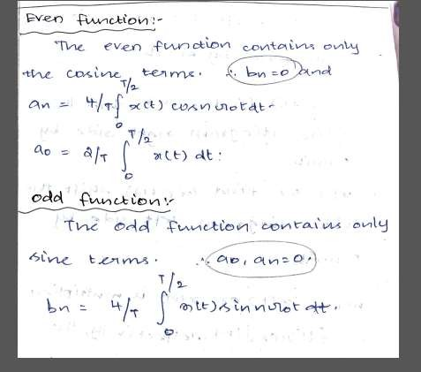
Trigonometric Fourier Series for Even and Odd Signals

